Slide 1
FCP ladder manual
〇Overall
・Control configuration
・Usable device area
〇Program detail
・Program components
・Rules of writng Sequence
〇Program editing method
・Add units and modules
・IO control setting
・Robot movement
・Camera operation
・Cycle time measurement
・In stock of work
・Error
・Interference area
・Communication between each modules
・Cycle stop

Slide 2
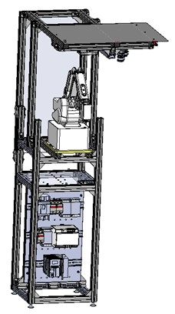
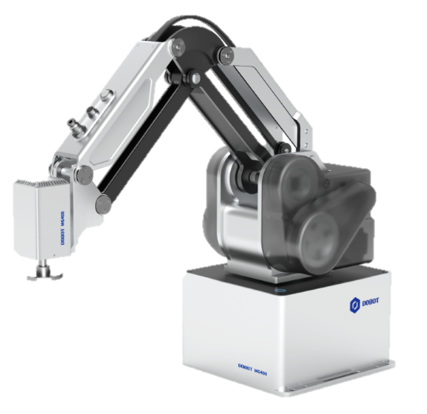
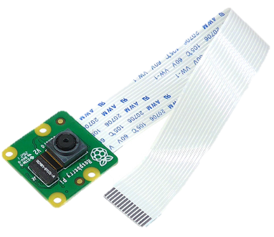
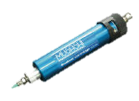
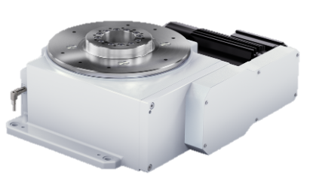
Overall
・Control configuration
- FCP grogram can be controlled 10 units and 10 touch panels.
- 1 unit can be consist of 1 robot and 9 modules
Overall control
PROG.
unit 1
unit 2
unit 10
Module overall
Control PROG.
touch panel
Control PROG.
Module 1
control
PROG.
( robot )
Module 2
control
PROG.
( camera )
Module 9 control
PROG.
( Dispenser, index, etc. )
・Program structure
The control program of each modules can be edited.
<= Unable to edit
unit 1
unit 2
unit 10
Copy when adding unit
Unable to edit
Address range
Copy when adding unit
Editable
* For address details, please see
See

Slide 3
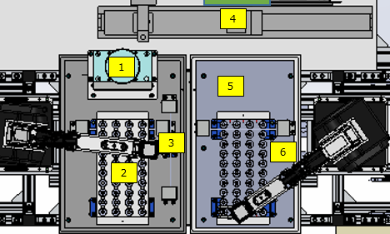
Usable device area
・There area two robot unit as shown in the picture below, then each unit control program use following device area.
When connecting other devices and configuring operation settings on the PLC, please use the address range below.
< Available address range >
DM25000~50000
EM25000~50000
R50000~100000
MR50000~100000
FM5000 ~
UN1
UN2
UN1 address range
UN2 address range
UN ＿ CTRL address range

Slide 4
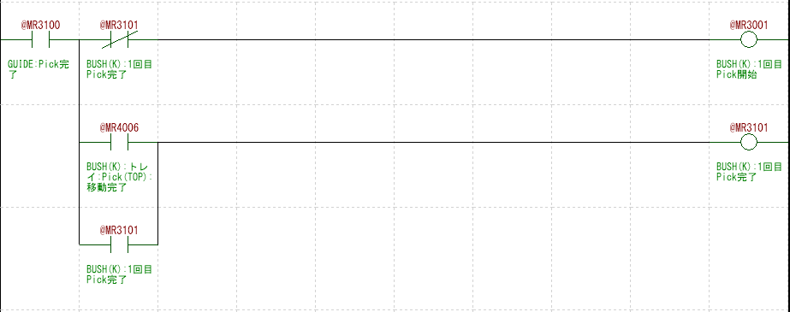
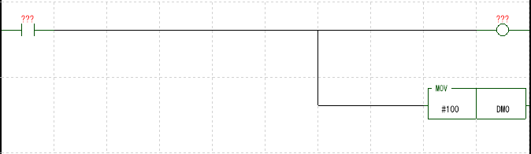
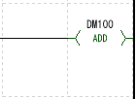
Program detail
Program components
-The program consists of following components.
1.Setting
2.Input
3.Pre Process
4.Cycle
5.Post Process
6.Function
7.Output
: Set parameters for each module
: Storing global variables to local variables
: Pre-cycle processing
: Cycle operation
: Post-cycle processing
: Robot/camera operation settings
: Storing local variables to global variables
Rules of writng Sequence
-Create sequences by combining movement blocks
sequence
Operation A start trigger
Operation A end trigger
@MR500
@MR100
@MR000
Operation A
start
Operation A completed
Operation A starts
@ MR000
@MR300
Movement
blocks
@ MR300
@MR100
Operation A starts
Actual operation A completed
Actual operation completed
Operation A completed
@MR100
Operation B start trigger
Operation B end trigger
Operation A completed
@MR100
@MR101
@MR001
Operation B
Operation A completed
Operation B completed
Operation B starts
@ MR001
@ MR400
@ MR400
@MR101
Operation B starts
Actual operation B completed
Actual operation completed
Operation B completed
@MR101
Operation B completed
・
・
・

Slide 5
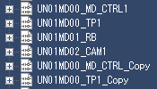


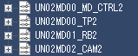
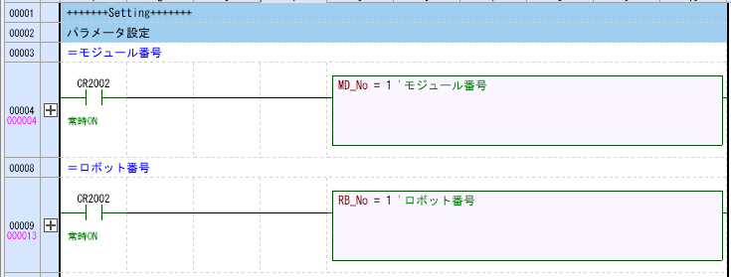
Add units and modules
· Overview
Change the number of units and modules.
- How to add the number of units
1. Copy and paste “CTRL” / “TP”
2. Change program name
Recommended name format : UN**DM**_Module name
* The number does not affect the program, “CTRL” automatically sets UN no.
- How to change the number of modules
1. Copy and paste module of “RM” or “CAM”
2. Change progrum name.
3. Set “MD_No” and ”RB_No”or”CAM_No” on bookmark”Seeting ”
MD_No: Module number within the unit * Cannot be duplicated within same unit
RB_No: Robot number is displayed ”RasPi ” of touch panel.
CAM_No : Camera number is displayed ”RasPi ” of touch panel.
1
2
* Be sure to use CTRL and TP in that order .
1
2
* Be sure to add the module after
3

Slide 6
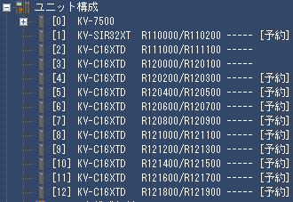
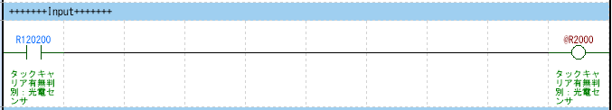
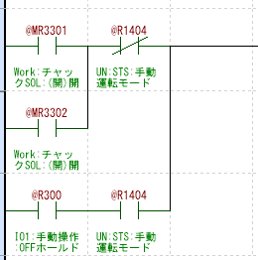
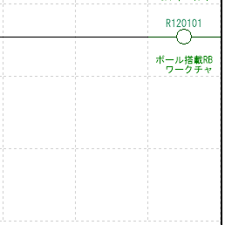
IO control setting
・IO input setting
1.match the IO unit which is connected to the PLC with the ladder ( cancel reservation )
2. Store in any local variable * Recommended : @R3000 , @LR000 or later
・IO output setting
1. Store the local device to the output global device on the output operation. Each input of auto operation and manual operation are connect normal open or normal close of manual operation mode, so that the outputs operate individually.
1. When using IO unit of common UN and only UN1 UN1
For common UN
For UN1
For UN2
For UN3
For UN4
For UN5
For UN6
For UN7
For Un8
For UN9
For UN10
Input on
Auto-operation
Input on
manualoperation

Slide 7
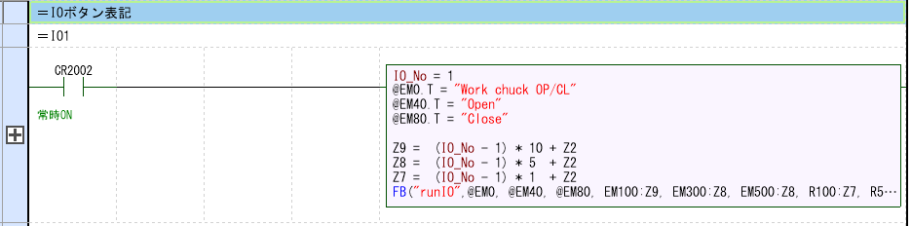
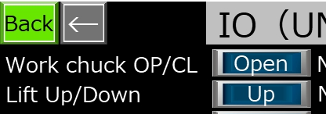
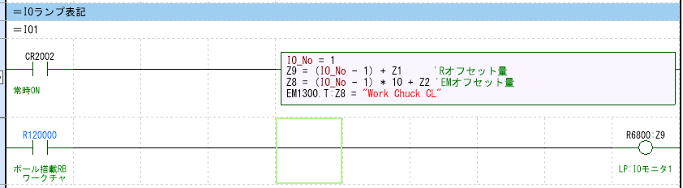
IO control setting
・Touch panel indication of IO item
1. Copy the ladder below for each item.
Enter the number of display items / display items / notation content during operation
・Lamp function
1. Copy the ladder below for each item and enter the number of items to display the lamp.
2.Sensor input is placed to detect the operation when the lamp is lit.
1st item =>

Slide 8
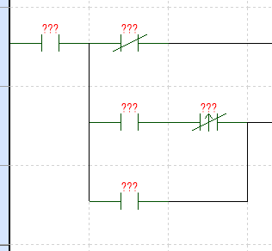
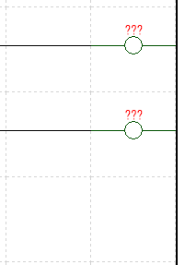
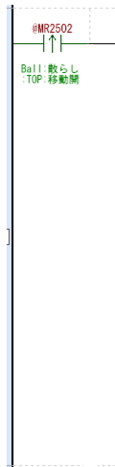
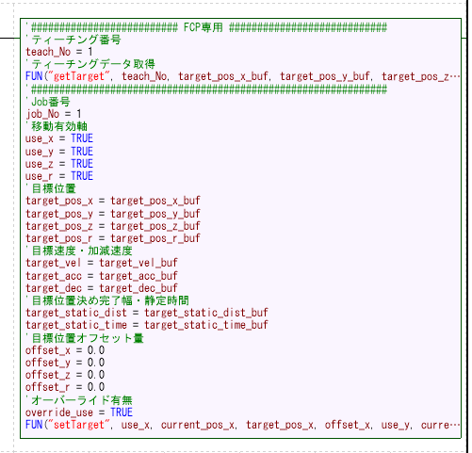
robot movement
・the start of robot is connected to the target position / trigger. To complete the actual operation, place the local device CMP_move . Normal close for robot movement start is placed on the right side of ( For stability during continuous robot operation )
Place at target position/trigger
・On setting the target position, robot movement start connect the following scripts and set various parameters necessary for robot operation .
@MR100
@MR100
@MR000
start
Robot movement 1 completed
Robot movement 1 start
CMP_move
@MR000
@MR100
Robot actual operation completed
Robot movement 1 starts
Robot movement 1 completed
@MR100
Robot movement 1 completed
Target position, speed, acceleration, positioning width, and settling time can be set by setting the teaching number. (FCP exclusive setting)
@MR000
Robot movement 1 starts
<= Set teach no.
<= Set motion axis condition
Operation = TURE / No operation = FALSE
<= Set target position
<= Set Vel. / Acc value
<= Set the positioning width and settling time
<= Set the offset value
<= Set override condition

Slide 9
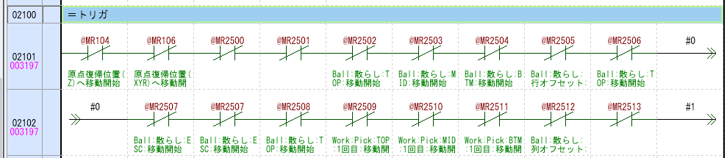
robot movement
・Add operation start on trigger setting area.
@MR000
Robot movement 1 starts

Slide 10
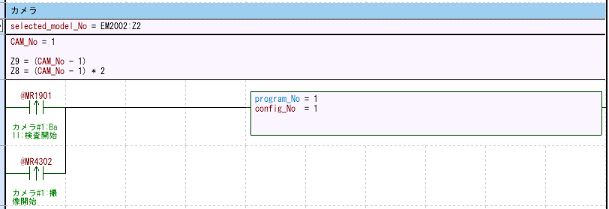
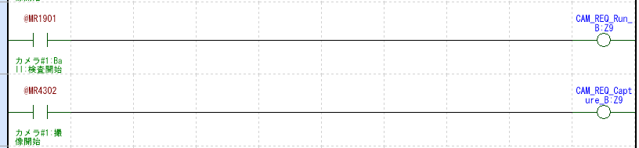
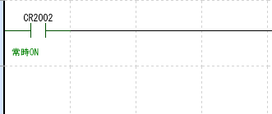
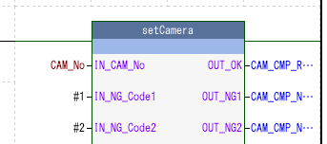
Camera operation (VAST)
・Camera control ladder
Copy the ladder below for each camera.

Slide 11
Camera operation (VAST)
・Camera settings
Camera No. is settind on area sprict.
The start signal of camera operatinon connect following sprict which is setting program no. / config no.
·Operation setting
To start camera inspection , connect CAM_REQ_Run_B:Z9 .
Connect CAM_REQ_Capture_B:Z9 for camera inspection imaging .
<= Set the camera No.
<= Set following parameter
Program_No / config_No.
camera operation
start signal
Inspection start signal
Imaging start signal

Slide 12
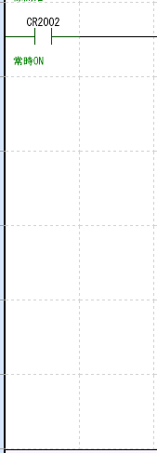
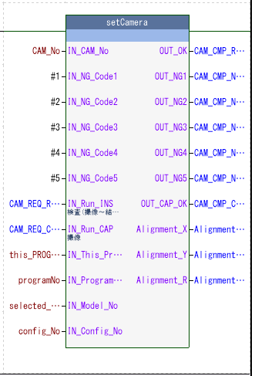
Camera operation (VAST)
・Function block ”setCamera“ is setting.

Slide 13
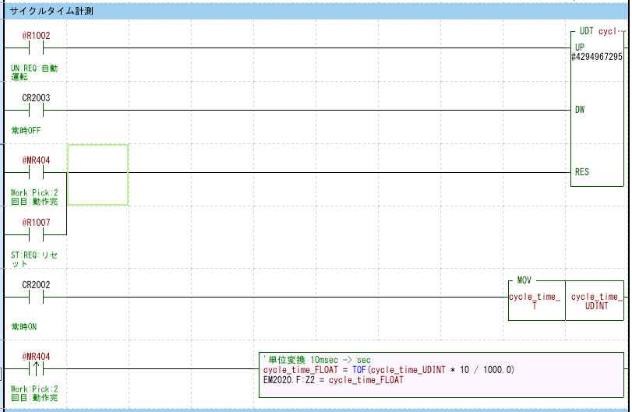
Cycle time measurement
・To measure cycle time of process, place signal of start or complete on process on following area.
Start process signal
Completed Process signal
Completed Process signal

Slide 14
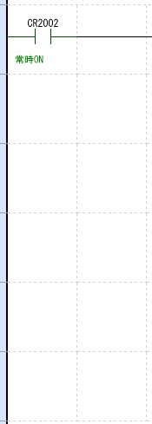
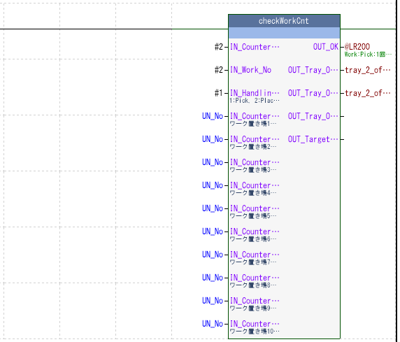
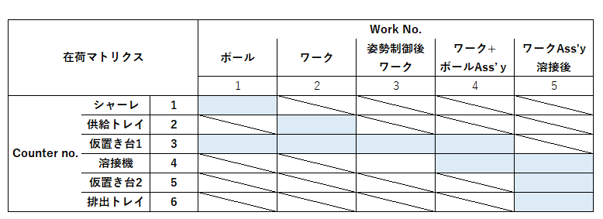
In stock of work
- By setting the work place, type of sample, and handling conditions, you can check whether handling is possible, the offset amount of the tray position during handling, and the position on the tray.
1. Set the parameters ( set the matrix as shown below )
2. Settings local device to check condition of stock or empty of place area.
2. Setting local device
1.Parameter settings
・Counter No. : Work area
・Work No. : Sample type
・Handling mode
(Pick=1, Place=2, Assembly=3)
・UN_No : Number for work location
(Fixed conditions)

Slide 15
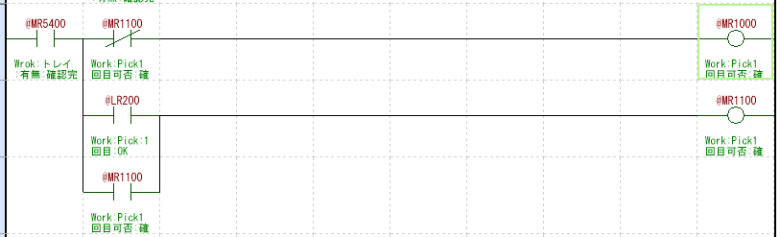
In stock of work
3. Incorporate local device shown on previous page into the inventory check flow as shown below, it is possible to have a check function before the robot starts moving.
No
connection

Slide 16
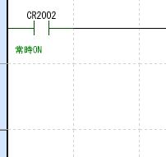
In stock of work – Exsample 1
・ On picking work No.2 from tray no.2, as following setting. If @LR200 is on, then work no.2 can be picked.
Counter no. ( sample placement location ) setting
Inventory Matrix settings
parameter settings
・Counter No.: 2
・Work No.: 2
・Handling mode: 1
(Pick=1, Place=2, Assembly=3)
・UN_No : Number for work location

Slide 17
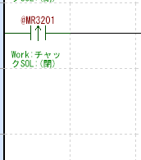
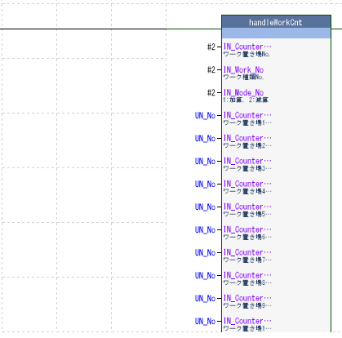
Stock count
・A function that counts the increase and decrease of samples when the arm opens and closes when picking /placing samples. Counter no. / Mode no. Unit mode is the same setting as work inventory. For exsample, the settings when picking a workpiece from supply tray 2 are as follows.
Counter no. ( sample placement location ) setting
Inventory Matrix settings
parameter settings
・Counter No.: 2
・Work No.: 2
・Mode No. : 2
( Addition =1,
Subtraction =2)
When
Chuck ( close ) signal
・UN_No : Number for work location
( Fixed conditions )

Slide 18
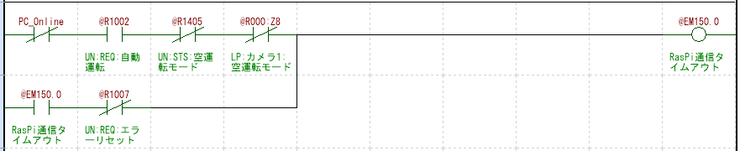
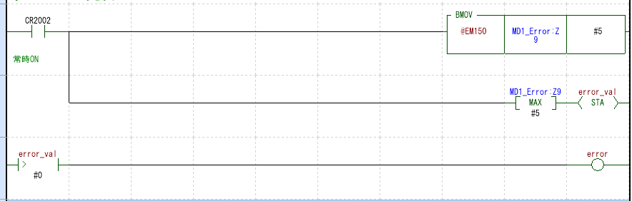
error
Some items treated errors connet to local device @EM15X.Y (X/Y can be set following and combinations
X : 0-4 / Y : 0-15)
By making the above settings, if there is one error item ,then Local device : error is ON, so error detection is possible.
error detection
local device
Items treated as errors

Slide 19
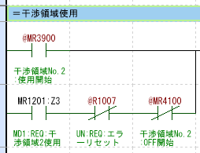
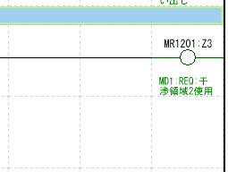
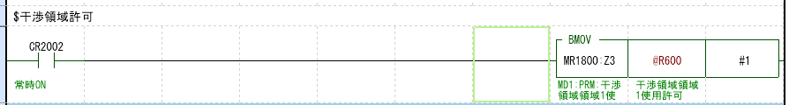
interference area
Setting to avoid contact between two robots when two robots move common area as following no.3 area.
By turning on MR12xx , the MR18XX condition check whether the common area can be used.
·setting
You can set 16 common areas by changing the XX: XX part of MR12XX :Z3 from 00 to 15 . ( Currently, up to 4 common areas can be set. Planned to expand to 15 )
By placing the ladder below in inter-program communication, the common area condition is reflected in @R6XX.
UN1
UN2
OK to use
MR18XX:Z3 -TURE
MR12XX:Z3
FB
checkCLSN
Not
MR18XX:Z3 -FLASE
Common area usage confirmation device
MR12XX:Z3
start to use
MR12XX:Z3
Completed use
MR18XX:Z3
@R6XX

Slide 20
interference area
A operation block of starting or end use of the interference area is installed before and after the robot motion sequence in the interference area. If the interference area is used by another unit, @ 6XX will not turn ON , so the Robot operation will not start, and it is possible to set the two robots to not operate in the common area.
Complete sequence of operations in interference area
operation block of start using interference area
@MR100
@MR100
@MR000
Start using
interference area
@ R6XX
Open close
start
Operation A completed
Operation A starts
@ MR300
@MR100
Actual operation completed
Operation A completed
@MR100
Operation A completed
Operation sequence
・
・
・
operation block of end using interference area
@MR101
@MR101
@MR 4100
End using
Interference area
Operation A completed
Operation B completed
Operation B starts
@R6XX normal close
@ MR400
@MR101
Actual operation completed
Operation B completed
@MR101
Operation B completed

Slide 21
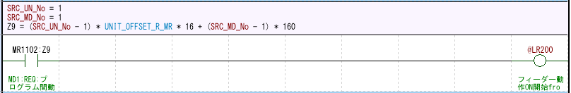

Program-to-program communication
・Input setting
Connect the signals required for unit control managed by the global device to any local device. 1 module 1word , input set to MR17XX .
・Output setting
Connect the signals used for controlling other units to the global device using the signals managed by the local device within the unit. 1 module 1word , Output MR11XX can be set.
Inside the unit
Operation completed
local device
MR17XX:Z9
between programs
Operation completed XX
Inside the unit
Operation completed
local device
MR11YY : Z9
between programs
Operation completed XX

Slide 22

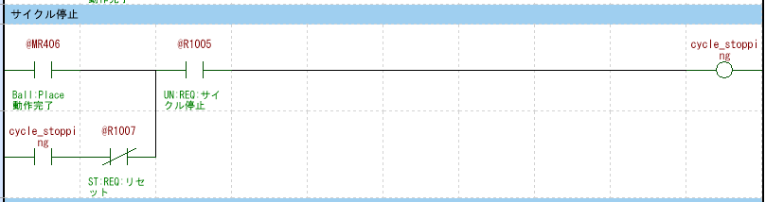
Cycle stop
・By arranging the local device “seq_stopping” and the arbitrary end signal of process as shown below, it is possible to end the operation at the end of any process during automatic operation by pressing cycle stop on the touch panel.
Local device “seq_stopping” is placed following position (after automatic operation start)
Place end signal of process complete which you want to stop process following position.
Start of automatic operation
s eq_stopping
Operation A completed
@MR000
@R1002
start
Actual operation completed
Operation A starts
@ MR300
@MR100
Operation A completed
Operation A completed
Operation A completed
@MR100
@MR101
@MR101
@MR 4100
Operation A completed
Operation B completed
Operation B starts
@ MR400
@MR101
Actual operation completed
Operation B completed
@MR101
Operation B completed
@MR101
Operation B completed

